Slide 1
Evidence-Based Reading Appropriate Text Selection for Adult Learners
Presented by Michael Tilley
June 8, 2021
This presentation will be recorded and shared for on-demand viewing.

Slide 2
Background on Evidence-Based Reading
Phonics
Vocabulary
Fluency
Comprehension
Phonemic Awareness
Components of Evidence-Based Reading Instruction
Notes:
In its simplest form, evidence-based reading instruction means that a particular program or collection of instructional practices has a record of success. That is, there is reliable, trustworthy, and valid evidence to suggest that when the program is used with a particular group of children, the children can be expected to make adequate gains in reading achievement. Other terms that are sometimes used to convey the same idea are research-based instruction and scientifically based research
There is no single instructional program or method that is effective in teaching all children to read. Rather, successful efforts to improve reading achievement emphasize identification and implementation of evidence-based practices that promote high rates of achievement when used in classrooms by teachers with diverse instructional styles with children who have diverse instructional needs and interest
n as the First-Grade Studies (Bond & Dykstra, 1967/1997). This series of U.S. federally funded investigations examined popular approaches to teaching beginning reading. Included were examinations of basal reading, phonics, language experience, and linguistics approaches to reading instruction. The collection of 27 studies comparing different methods and materials found as many differences between and among teachers using the same program or approach as there were between and among teachers using different programs or approaches, leaving the authors unable to identify a “best” program. Instead, the results led the authors to conclude, Children learn to read by a variety of materials and methods.... No one approach is so distinctly better in all situations and respects than the others that it should be considered the one best method and the one to be used exclusively. (Bond & Dykstra, 1967/1997, p. 416)

Slide 3
Overview
Define text selection and its roles as an essential component of reading
Explore technology tools that assist in scaffolding reading assignments
Discuss how to incorporate Lexile levels in text selection
Notes:
Selecting culturally appropriate reading material
Technology tools that assist in scaffolding reading assignments
How to incorporate Lexile levels in text selection.

Slide 4
Selecting Texts
Notes:
Selecting Texts
Texts need to be developmentally appropriate and interesting for students. The more students can relate to the information, the more likely they are to engage. You can start with a survey in the beginning of the unit about student interests and try to pair their interests with standards based on topics you need to cover.
You'll also want to choose a text difficulty that is the sweet spot of learning. You don't want to choose a level that they are already comfortable with, as this won't provide opportunities for growth. But, a text that is far above their reading level will only end in frustration and disengagement.
A text at an appropriate level is something that is a little more challenging than what they can already do, but still in their reach to comprehend with support. As mentioned earlier, it's important to look at data to decide on appropriate for your students.
Each student may have a different level as well. Some tools are available to teachers to choose the same reading, but select different grade levels. The difficulty of the text and vocabulary goes down, but your students are still getting the same information. Another choice is to use the same reading for all students, but provide scaffolding, a technique used to support students while giving them the same difficulty of work. This might be bolding vocabulary words, providing a vocabulary list, giving checklists for reading strategies, or modeling annotation.

Slide 5
Pre-Reading and During Reading Strategies
Notes:
Pre-Reading Strategies
Getting students excited before you start reading increases engagement when students actually need to read. Start by getting students involved by accessing their prior knowledge. You can ask them what they already know about a topic, or show them a video clip about the topic to get them excited. For example, a scientific text on ecosystems might be challenging, but an opening clip of carnivorous grasshoppers might help them buy in.
Pre-teaching vocabulary is another important strategy. What challenging words are students likely to encounter upon reading? Can you go over some of them beforehand and then reinforce the definition with the reading? Students can also make their own vocabulary lists as they read to take ownership of their learning.
Word walls are a great way to showcase new vocabulary for a reading
Developing essential questions for your unit, or an overarching theme is important. Give your students a lens through which to view the reading. Are they focusing on the interactions between animals, practicing reading strategies, learning new vocabulary or a combination? Giving students some focus can help keep your lesson on track.
During Reading
You might think of reading as just sitting quietly, and well, reading. However, students need structure, especially if they are behind grade level. Consider reading as a class and modeling internal reading strategies. After reading a paragraph, ask students what you might ask yourself in your head. What was this paragraph about? Have them write these things down to teach annotation. In addition to modeling as a class, you can provide scaffolded areas to write notes on the reading. Having the lines to write something in reminds students they should be taking notes.

Slide 6
Text Selection Components
Complexity
Diversity and Representation
Critical Literacy
Reader and Task Considerations
Notes:
CONSIDERATION I COMPLEXITY This section quantitatively and qualitatively evaluates the inherent elements of a text. Quantitative factors refer to word length or frequency, sentence length and text cohesion; these dimensions are measured by computer software. Qualitative factors are measured by an attentive reader, reflect a teacher’s professional judgment, and refer to levels of meaning, purpose, structure, language features (such as conventionality and clarity) and knowledge demands.
CONSIDERATION II DIVERSITY AND REPRESENTATION This section considers the ways in which the author and characters in a text contribute to the inclusion of diverse voices in the curriculum. Similar to text complexity, diversity and representation are inherent elements of a text.
CONSIDERATION III CRITICAL LITERACY Critical literacy teaches readers to actively and reflectively engage with texts. Readers use critical literacy skills to interpret messages and challenge the power relationships found within those messages. They are encouraged to question social norms and institutions like family, poverty, education, equity and equality. This section of the tool asks users to determine if a text is a good candidate for critical literacy instruction.
CONSIDERATION IV READER AND TASK CONSIDERATIONS Culturally responsive text selection includes finding texts that both reflect your students’ identities, experiences and motivations (mirrors) and provide insight into the identities, experiences and motivations of others (windows). This section asks users to consider whether texts act as windows or mirrors and to explicitly name how the text will help meet established learning goals.

Slide 7
Complexity
Notes:
CONSIDERATION I COMPLEXITY This section quantitatively and qualitatively evaluates the inherent elements of a text. Quantitative factors refer to word length or frequency, sentence length and text cohesion; these dimensions are measured by computer software. Qualitative factors are measured by an attentive reader, reflect a teacher’s professional judgment, and refer to levels of meaning, purpose, structure, language features (such as conventionality and clarity) and knowledge demands.

Slide 8
Diversity and Representation
Notes:
CONSIDERATION II DIVERSITY AND REPRESENTATION This section considers the ways in which the author and characters in a text contribute to the inclusion of diverse voices in the curriculum. Similar to text complexity, diversity and representation are inherent elements of a text.

Slide 9
Critical Literacy
Notes:
CONSIDERATION III CRITICAL LITERACY Critical literacy teaches readers to actively and reflectively engage with texts. Readers use critical literacy skills to interpret messages and challenge the power relationships found within those messages. They are encouraged to question social norms and institutions like family, poverty, education, equity and equality. This section of the tool asks users to determine if a text is a good candidate for critical literacy instruction.

Slide 10
Reader and Task Consideration
Notes:
CONSIDERATION IV READER AND TASK CONSIDERATIONS Culturally responsive text selection includes finding texts that both reflect your students’ identities, experiences and motivations (mirrors) and provide insight into the identities, experiences and motivations of others (windows). This section asks users to consider whether texts act as windows or mirrors and to explicitly name how the text will help meet established learning goals.

Slide 11
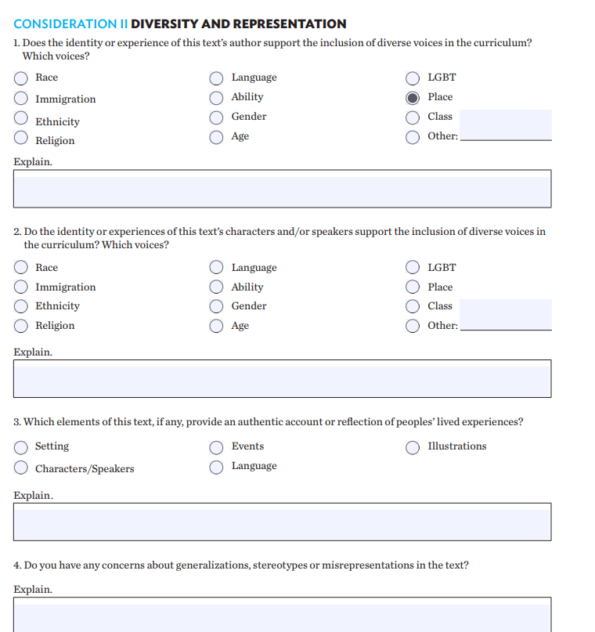
Breakout Room Activity: Finding a Lexile Level of a Book
Open learningforjustice.org
Identify a text that takes Diversity and Representation into consideration
Prepare to share the text you selected and what level could use it
Notes:
https://www.learningforjustice.org/sites/default/files/2017-11/Reading-Diversity-v2-Redesign-WEB-Nov2017_0.pdf
Identify a text that takes Diversity and Representation into consideration
Prepare to share the text you selected and what level could use it

Slide 12
Lexile Level
Method used to measure a reader’s ability
Valuable tool for teachers and students
Measure how difficult a text is
Notes:
hat Is a Lexile Level? A popular method used by schools to measure a student reader’s ability is Lexile level or a Lexile Measure. A Lexile measure is a valuable tool for teachers, parents, and students. It serves two unique functions: it is the measure of how difficult a text is OR a student’s reading ability level. The Lexile Framework was developed by MetaMetrics©, an educational assessment and research team, funded originally by the National Institute of Child Health and Human Development.
What Does Lexile Score Mean? A student receives his or her Lexile measure from one of two ways: taking a school administered SRI (Scholastic Reading Inventory) test, which is specifically designed to measure Lexile or reading ability OR by taking a standardized reading test which converts the reader’s results to a Lexile measure. If a student gets a 550L then he or she is a 550 level Lexile reader. 550L is the measure of his or her readability level.
The ideal for both reader and text is to match both their assessed Lexile measure. For example a book or magazine with a 770L and a reader assessed at a Lexile level of 770. The reading levels per classroom are wide-ranging and varied. There are many factors that go into matching a student to his or her ideal text. The Lexile Framework is a good place to start in picking the right book at the right Lexile level as it targets areas in need of intervention and encourages achievement across grade levels and curricula.

Slide 13
Using Lexile Levels in the Classroom
Teachers can use Lexile Levels to help them:
Develop individualized or classroom reading lists tailored to provide appropriately challenging reading.
Enhance thematic teaching by building a bank of titles at varying levels that support the theme, but also allows all students to participate successfully in the theme with material at their own reading level.
Sequence materials, for example by increasing the difficulty of read-aloud books throughout the year.

Slide 14
Grade Equivalencies and Lexile Bands
Notes:
The Lexile® Framework helps to describe the text complexity necessary for students to meet the demands of colleges and careers. This redesign now displays college and career ready “stretch” Lexile bands. These college and career bands, also known as “stretch” bands, of the Lexile® Framework show an upward trajectory of reading comprehension development through the grades to indicate that all students should be reading at the college and career readiness level by no later than the end of high school. Georgia’s content standards focus both on text complexity of what students read and how well students read and comprehend. The Lexile bands in the table below help teachers and parents determine what text is appropriate for each grade band and what should be text that will stretch the students and help them gain in literacy skills. Students should have regular practice reading written texts within the “stretch” Lexile band for each year in order to be on the pathway to be college or career ready upon high school graduation.

Slide 15
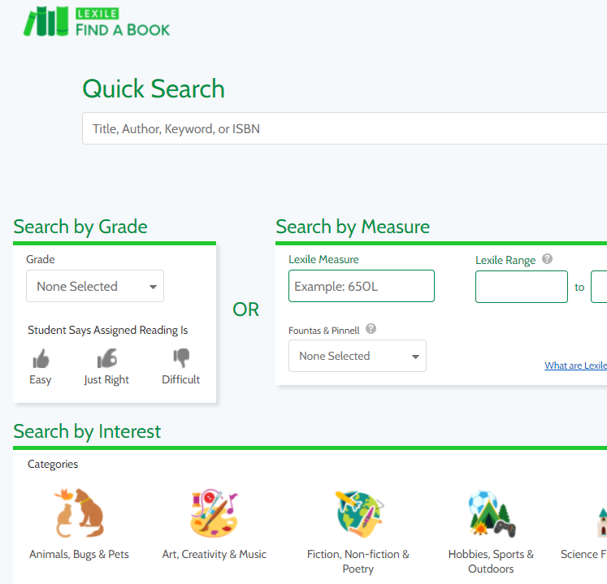
Breakout Room Activity: Finding a Lexile Level of a Book
Open hub.lexile.com/find-a-book/search
Find a book at an appropriate level for your class
Share with the group why you selected the text you did
Notes:
Open hub.lexile.com/find-a-book/search
Find a book at an appropriate level for your class
Share with the group why you selected the text you did
A
Find Books at the Right Level
There’s more than one way to use Lexile measures to find the right books for engaging students and encouraging reading.
Using a student’s Lexile reading measure as a starting point, it’s easy to find books that provide the just-right amount of challenge to advance their reading skill development. Explore below all of the ways you can find materials with the content that sparks student interest and is also the right level of difficulty.

Slide 16
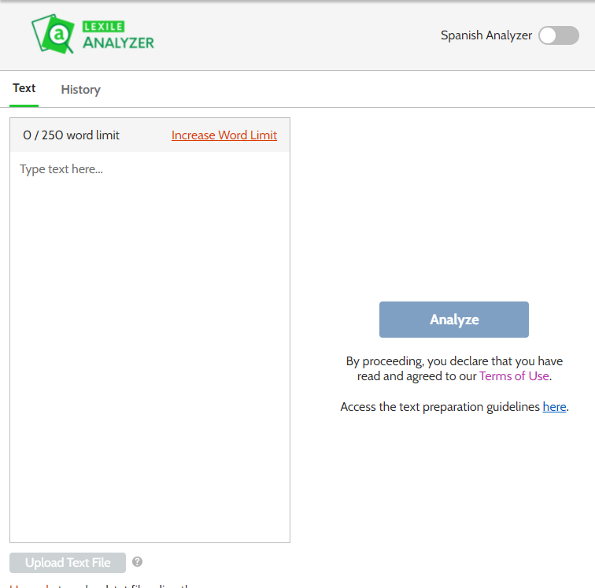
Lexile Analyzer
Notes:
The Lexile Analyzer
The Lexile Analyzer uses an algorithm to evaluate the reading demand — or text complexity — of books, articles and other materials. The Lexile Analyzer measures the complexity of the text by breaking down the entire piece and studying its characteristics, such as sentence length and word frequency, which represent the syntactic and semantic challenges that the text presents to a reader. The outcome is the text complexity, expressed as a Lexile measure, along with information on the word count, mean sentence length and mean log frequency.
Generally, longer sentences and words of lower frequency lead to higher Lexile measures; shorter sentences and words of higher frequency lead to lower Lexile measures. Texts such as lists, recipes, poetry and song lyrics are not analyzed because they lack conventional punctuation.
Spanish text can also receive Lexile measures. Simply select the “Spanish Analyzer” toggle in the top, right corner of the Analyzer to measure Spanish texts.

Slide 17
Text Selection Tools
The Times in Plain English
Breaking News English
Newsela
Notes:
• Initial planning/placement: Informal assessment activities or tests may be useful in identifying phonemic awareness skills and deficits. A formal test may be more accurate than other measures.
• Ongoing progress monitoring: Informal activities built into instruction are probably the best way to monitor growing phonemic awareness and identify problems.
• Outcomes measurement: Phonemic awareness is not an end in itself; it is important because it is required for developing decoding skills. A test of decoding skills may suffice as an outcome measure.

Slide 18
Select Texts Purposefully
Teach reading comprehension with multiple genres of text
Choose texts of high quality with richness and depth of ideas and information
Use texts that support the purpose of instruction
Choose texts with word recognition and comprehension difficulty appropriate for the students’ reading ability and the instructional activity
Notes:
Teachers should use both literary and informational texts in reading comprehension instruction, including both printed and digital texts, because a student’s mastery of one does not necessarily transfer to the other. State standards may provide additional guidance on which genres students should be able to comprehend at a given grade level. Narrative texts portray a story, or sequence of related fictional or nonfictional events involving individuals or fictional characters; in the elementary grades, narrative texts can include historical fiction, fables, and autobiographies. Informational texts include expository writing, pieces that argue in favor of one position or another, and procedural texts and documents. In the elementary grades, informational texts can include news articles, speeches, and timelines.
Stories with strong literary value and informational texts that are accurate, well-written, and engaging are consistently good choices for teaching reading comprehension. When selecting texts, teachers should look for characteristics such as rich content (e.g., character development in literary text or elaborate detail in informational text), strong organization, and variation and richness in word choice and sentence structure.
When selecting a text, teachers should consider textual/linguistic demands (e.g., word decoding, sentence complexity and text organization, layout/formatting) and content demands (e.g., how complex, abstract, or subtle the information is), keeping in mind that these two aspects of difficulty can vary within the same text. Teachers should provide students with opportunities to read texts that are appropriately challenging and consider activities, such as shared reading or guided reading, in which more challenging texts might be appropriate, as support from the teacher is more available. Additionally, selecting texts that align with student interest and background knowledge may also increase their motivation to persevere in comprehending a more challenging text
Reading comprehension lessons should be focused on (1) increasing students’ ability to apply reading comprehension strategies; (2) expanding their knowledge of specific genres, structures, and texts; or (3) developing their ability to engage in higher-order discussions about the text. The table below provides some evidence-based suggestions for teachers.

Slide 19
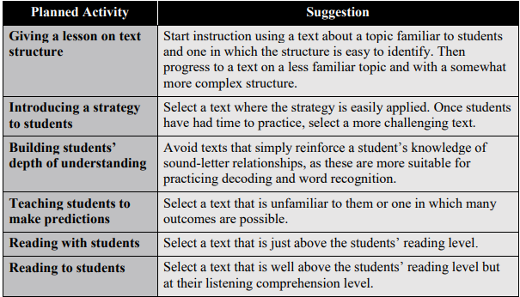
Texts that Support the Purpose of Instruction

Slide 20
Breakout Room Activity: Selecting Text for Reading with Students
Identify a text that you would read with your class
Identify the Lexile level
Discuss how this text is appropriate to read with your students
Notes:
Identify a text that you would read with your class
Identify the Lexile level
Discuss how this text is appropriate to read with your students

Slide 21
Resources
https://www.learningforjustice.org/sites/default/files/2017-11/Reading-Diversity-v2-Redesign-WEB-Nov2017_0.pdf
https://d1jt5u2s0h3gkt.cloudfront.net/m/cms_page_media/123/Lexiles-in-the-Classroom.pdf
https://www.gadoe.org/Curriculum-Instruction-and-Assessment/Assessment/Pages/Lexile-Framework.aspx
https://files.eric.ed.gov/fulltext/ED597128.pdf
https://www.fluentu.com/blog/educator-english/esl-short-stories-for-adults/
https://hub.lexile.com/find-a-book/search

Slide 22
Reflections

Slide 23
Thank you for attending!

